Slide 1
ABC Company
Office Relocation
Project kick-off
December 5th 2023

Slide 2
Agenda
Project Overview
Project Approach, Objectives, Scope & Timelines
Next Steps
Appendix
A – Detail deliverables timeline

Slide 3
What are we trying to accomplish?
Overview
Set up new IT infrastructure for new offices
Replace existing server and networking equipment
Improve the security with Cloud connectivity and new firewalls
Highlights!

Slide 4
Why it is important to the ABC company?
Overview
The benefit are:
Upgrade to latest IT infrastructure with better security
Increase our productivity with flexible working location
Reduce operation expense
Highlights!

Slide 5
Why should you get involved?
Overview
Managing IT operations
implementing new hardware
Working with vendors and suppliers
Ensuring infrastructure and system configuration settings conform to agreed standards, and changes are managed and approved
Management and acceptable use of IT assets
Protection and stewardship of Company’s data
Highlights!

Slide 6
What approach are we taking?
Project Details
Consolidate five offices into two office
Purchase new IT infrastructure for both office as existing hardware is almost end of support
Using VMware virtualization technology to optimize the efficiency of the servers and reduce the costs
Configure Active Directory connection with Azure to enhance security

Slide 7
Project Scope
Project Details
Kickoff meeting
Install and configure 2 servers in main office and 1 server in branch office
Install and VMware vSphere in each server
Configure Active directory domain service with Azure connection and migrate existing data to new Active directory domain controller
Install and configure Windows file server, create shared folders, and set up permissions, migrate data from existing file server
Install and configure the print server, add printers, and configure printer drivers
Install and configure the network switch in both office, set up VLANs, and configure port security
Install and configure the firewall in both office, set up rules, and configure VPN access
Install and configure the access point, set up wireless security, and configure the SSID
Configure server backup to Azure
User training

Slide 8
Project Out of Scope
Project Details
Perform AD group policy configuration
Printer installation
Backup policy configuration
Azure account opening
Network connection between main office and branch office

Slide 9
Milestone
Project Details
Milestone | Description | Date
Project Kick-off and Initiation | Initiating the project | September 1, 2023
Requirements Gathering and Analysis | Gathering and analyzing project requirements | September 8, 2023
Procurement | Procuring necessary resources | September 15, 2023
Infrastructure setup - Main office | Setting up main office infrastructure | October 13, 2023
Infrastructure setup - Branch office | Setting up branch office infrastructure | November 3, 2023
Testing and Quality Assurance | Conducting tests and ensuring quality | November 24, 2023
User Training | Training sessions for end-users | December 1, 2023
See appendix A for detail deliverables timeline

Slide 10
Schedule baseline
Project Details
Task | Duration
Project Kick-off and Initiation | 1 Week
Requirements Gathering and Analysis | 1 week
Procurement | 4 Weeks
Infrastructure Setup and Installation | 6Weeks
Testing and Quality Assurance | 1 Week
User Training | 2 Weeks
Project Closeout | 1 Week
See appendix A for detail deliverables timeline

Slide 11
Deliverables
Project Details
Document Deliverables | Product related Deliverables
Rack layout document | Active directory domain controller(ADDC)
Hardware configuration document | File server with backup to Azure
User acceptance plan | Print server
Network diagram | Networking switches
 | Firewall
 | Wireless access point
See appendix A for detail deliverables timeline

Slide 12
How Can You Help?
Next Steps
Project Manager to manage the entire project
Project team members to implement the changes
Weekly project meetings between team members to review the project status
Bi-weekly project status meetings to report the status to the management
Weekly status reports to be distributed to all team members, management and stakeholders
Collaboration is the key to the success of the project!

Slide 13
Quality Management
Objective: Ensure all project deliverables meet specified quality standards.​
Quality Assurance:​
Process Audits: Regular audits for process and procedure compliance.​
Training and Skill Development: Team training for enhanced skills.​
Documentation Review: Ensure accuracy, completeness, and standards adherence.​
Process Improvement: Continuous improvement based on lessons learned and feedback.​
Quality Control:​
Peer Reviews: Regular reviews for identifying and rectifying issues.​
Testing and Validation: Rigorous testing for functionality, security, and performance.​
User Acceptance Testing (UAT): End-user participation to validate system alignment with needs.​
Feedback Mechanism: Establish a mechanism for stakeholder feedback.​
Defect Tracking: Document, track, and promptly resolve identified defects.​
Roles and Responsibilities:​
Project Manager: Overall responsibility for quality management.​
Quality Assurance Team: Conducts audits, provides training, and monitors compliance.​
Quality Control Team: Conducts testing, peer reviews, and ensures deliverable quality.​
Project Team: Collaborates with QA and QC teams to meet quality standards.​
​

Slide 14
Next Steps
Next Steps
Obtain approval of the project charter and project plan
Meet with managers to identify members to participate in project activities
Schedule resources
Orientation session for project participants

Slide 15
Q&A

Slide 16
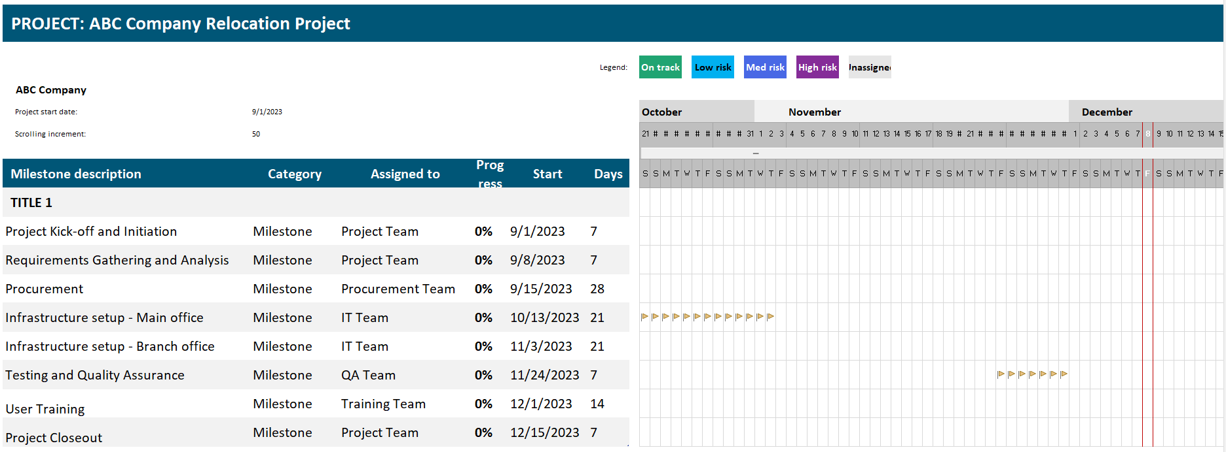
Detailed Deliverables Timeline
Appendix A

